Slide 1


Food Insecurity & Healthcare Availability
Nathan Connell
Lisa Modenbach
Keely Wright

Slide 2
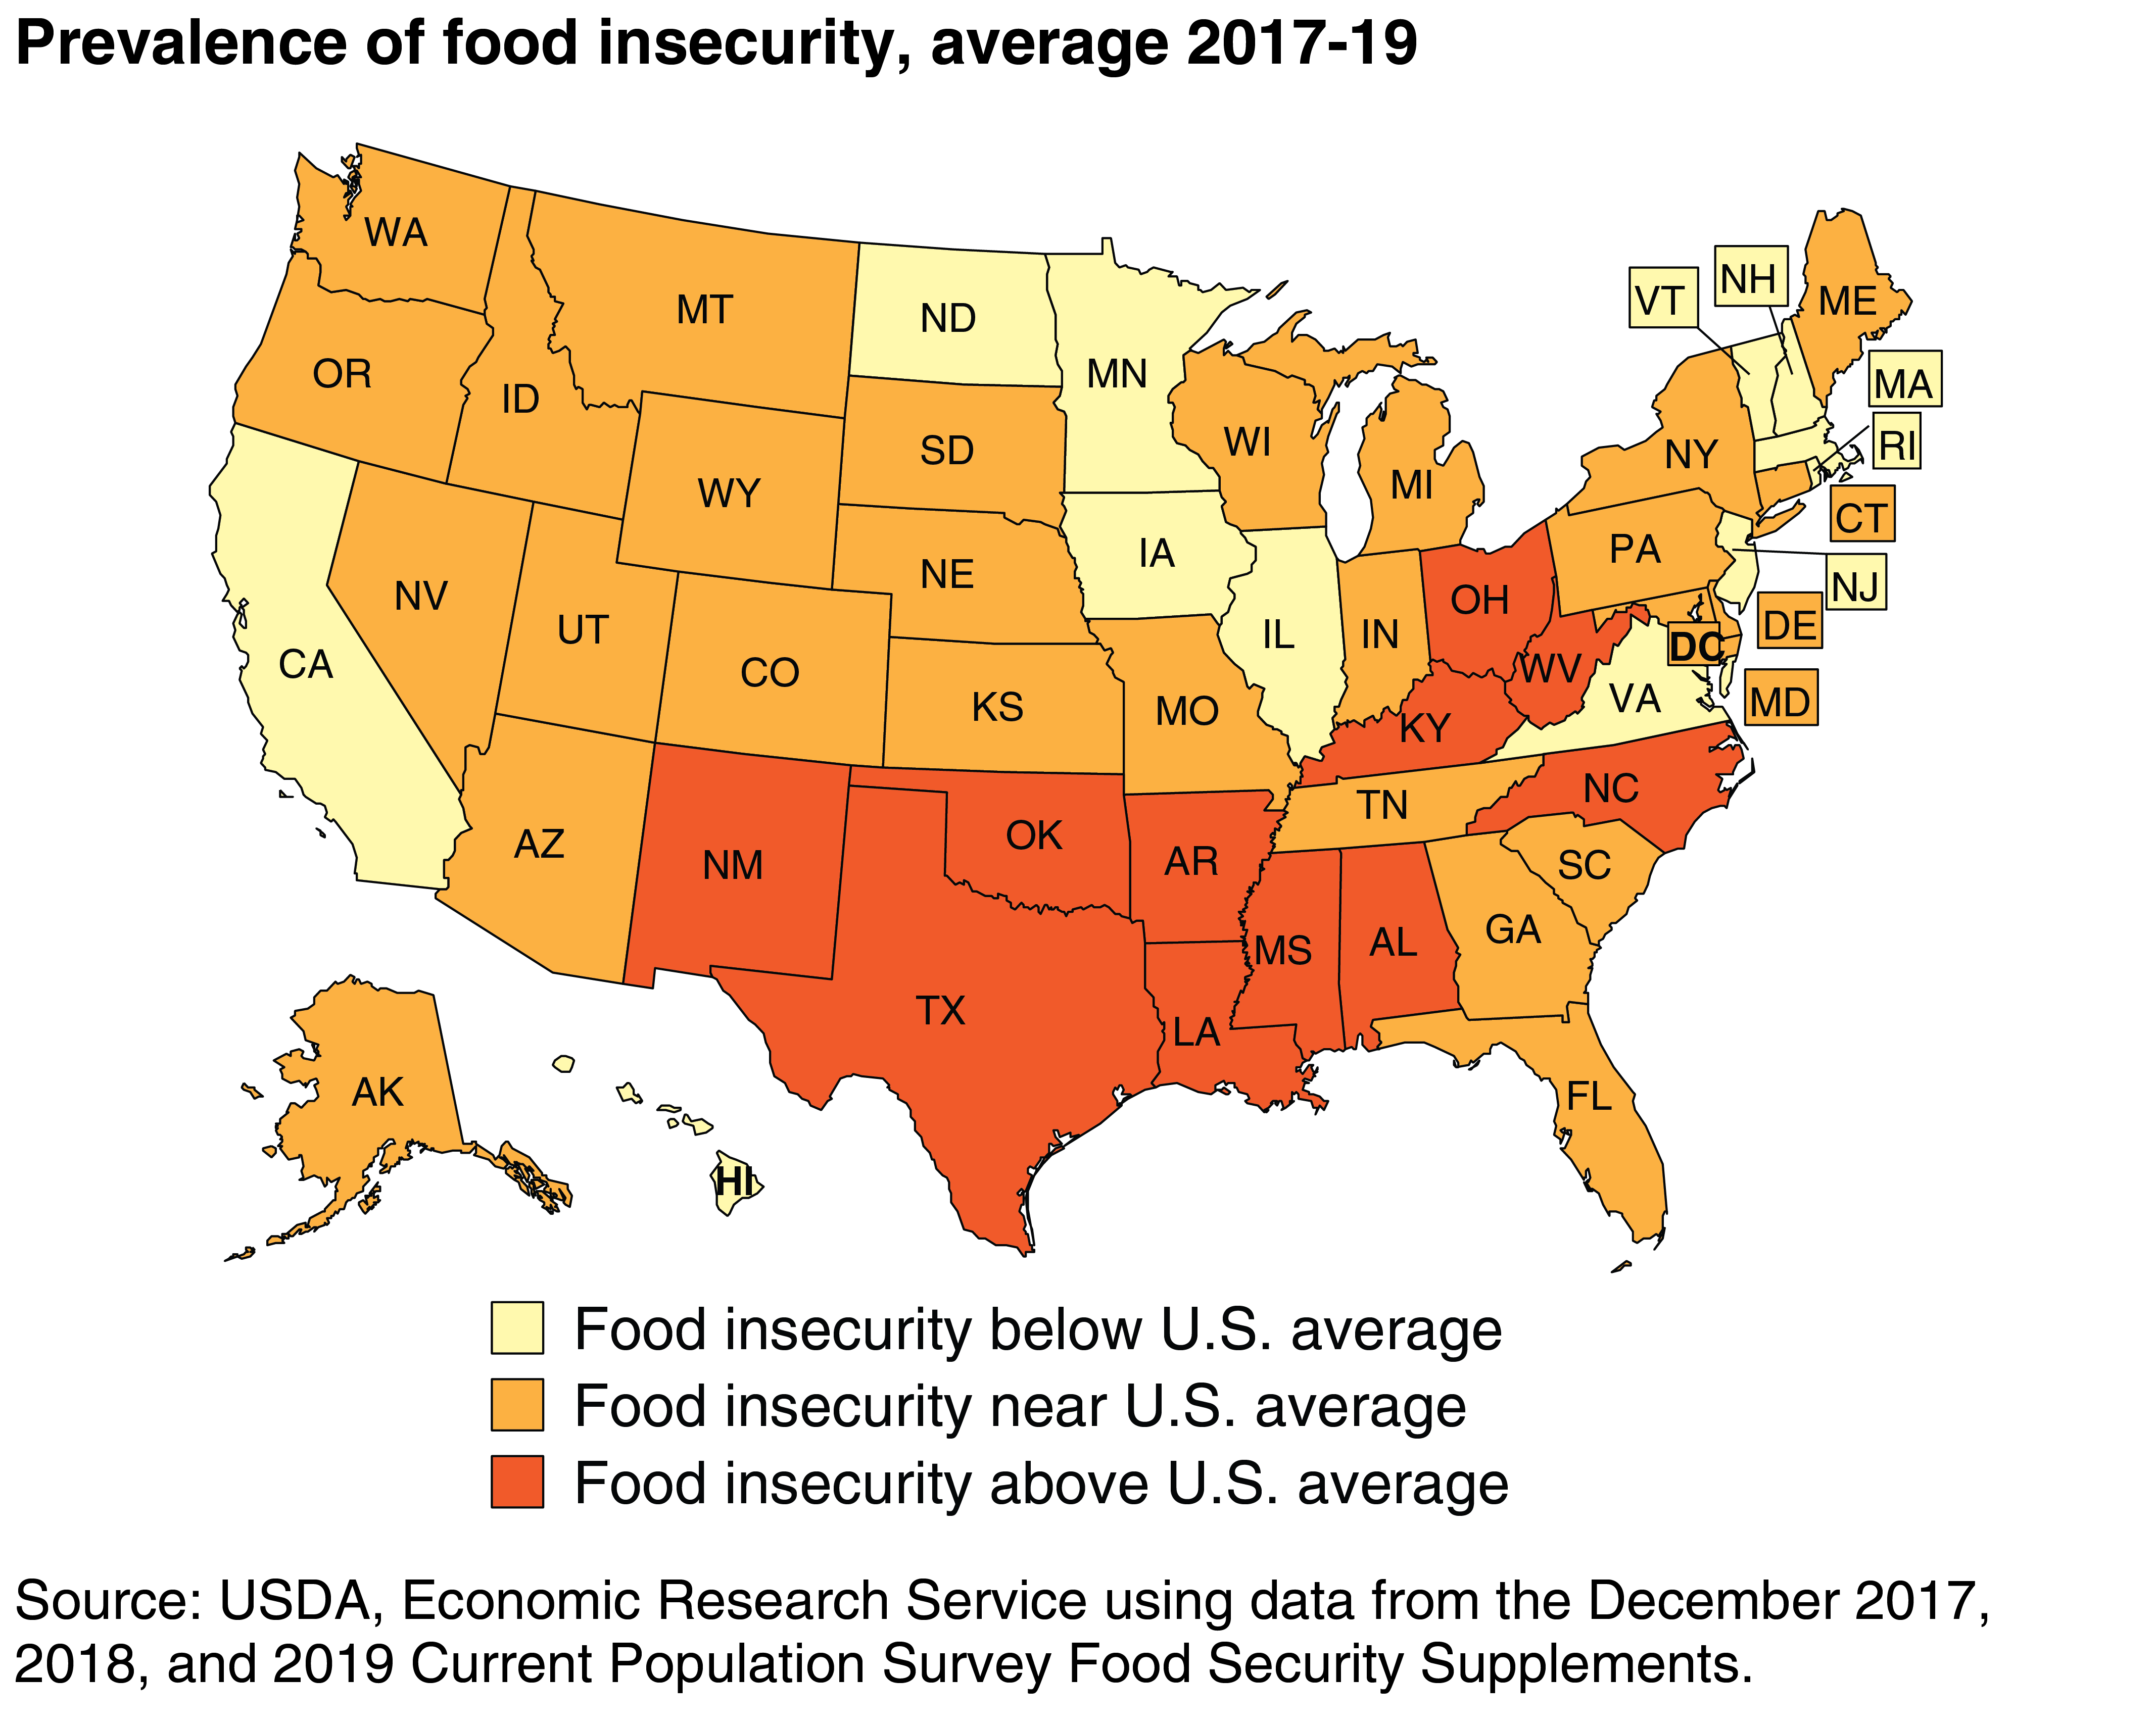
Notes:
One in ten (10.5 percent) of households in the U.S. experience food insecurity. Households in rural areas are experiencing considerably deeper struggles with hunger compared to those in metro areas, with higher rates of food insecurity overall (12.1 percent compared to 10.3 percent).
Hunger & Poverty in America - Food Research & Action Center
https://frac.org › hunger-poverty-americ

Slide 3
Core Questions
Is there a correlation between food insecurity and access to healthcare?
Does the geographical distribution of ethnicity show interesting relationships?
Our analysis was limited by not having enough time to study outcome metrics
Also limited by lack of diverse, robust food insecurity data
Notes:
Overlay food insecurity and access to healthcare
Compared this information to geography of ethnicities in California

Slide 4
Nathan’s Data
Healthy Places Index
read in Healthy Places Index csv file
removed all rows that did not contain a hpi2 value
calculated the insured percentage value iqr, lower quartile, and upper quartile for each county to find outliers
removed all outlier rows from the dataset
generated a heatmap of each census tract weighted by the percentile value of insured compared with the population mean
to correct for colors so that higher values were green and lower values were red, all values were subtracted from 100
calculated aggregate statistics of the percentage insured grouped by county
merged the aggregate statistics with the lat/lng values obtained from census.gov for the county center
generated heatmap of the median % insured by county
to correct for colors so that higher values were green and lower values were red, all values were subtracted from 100

Slide 5
Lisa’s Data
Map the Meal Gap food insecurity projections
read in map the meal gap data and load in df
loc on California entries
drop unnecessary columns
drop nulls
read in county center Lat/Lng and load in df
confirm Lat/Lng by county in same order as meal gap data by county
heatmap using % food insecure as weight so that red is worse, Lat/Lng from county centers
Ethnicity
read in central Lat/Lng for each county and load in df
read in ca ethnicity by county and load in df
drop unnecessary columns
calculate a minority count by adding all minority counts
calculate white %, minority % using counts and total population
identify two largest minority groups in census quick facts for CA
get % for two largest minority groups combined and four smallest combined using addition over total population

Slide 6
Keely’s Data
Primary Care Shortage Areas
read in central Lat/Lng for each county and load in df
read in shortage area csv and load in df
drop unnecessary columns from shortage areas, then nulls based on physician ratio score (target) column
merge both dfs on county name
drop further unnecessary columns
group multiple county entries by county, using a mean of the Lat/Lng values and a median of ratio score (median avoids outlier skewing)
heatmap weighted on ratio score where redder is worse and green is better
Medi-Cal fee for service providers
read in provider data and load in df
drop unnecessary columns
loc on providers in categories that aren't extreme specialties
loc on providers whose county code is not unknown
value counts on unique counties for num providers there, sort=False to keep alpha order to match up to Lat/Lng list
use aggregation to group by county and get mean of Lats and Lngs for that county's entries
get mean and median of value counts to have an idea of max intensity for heatmap
heatmap with weights as num providers (value counts)
reverse google's default RGBA values for map so green means more providers, adjust opacity (alpha value) a bit for viewability

Slide 7
Summary
Potential barriers impacting the group
Time difference between members was overcome using slack for communication and git hub repository for documentation.
Loss of a group member after workflow assignments required redistribution of data and change in scope
If there were additional time we would:
Add disease indicators to further analyze impact of food insecurity on community health

Slide 8
Keely’s Map
MSSAs are geographic units based on population, demographic, and physician data.
Physician Ratio Score is the population-to-provider ratio of the MSSA.
Calculated as Total_Population / EST_Providers.
Allocation of student loan forgiveness is based on need in a given area

Slide 9
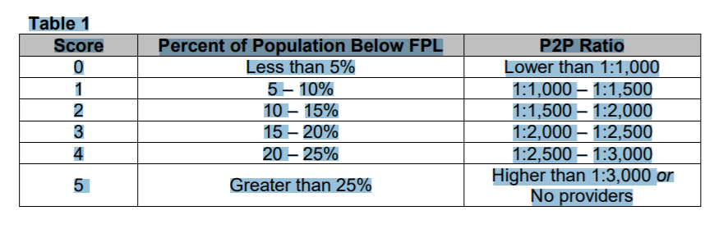
Physician Ratio Score
Notes:
The Commission uses PCSAs to inform Song-Brown Program funding decisions for Primary Care Residency and Family Nurse Practitioner/Physician Assistant training programs. OSHPD calculates a score for each MSSA according to criteria the Commission established. The criteria are (1) percent of the population living below the federal poverty level (FPL), and (2) the provider-to-population (P2P) ratio. Each component is worth up to five points. Table 1 summarizes the scoring rubric:
MSSAs are geographic units based on population, demographic, and physician data. The Federal Health Resources Services Administration (HRSA) formally recognizes California’s MSSA unit of geography as the Rational Service Area for medical service in California.

Slide 10
Nathan’s Sources
Healthy Places Index
SOURCE: https://healthyplacesindex.org/data-reports/
SOURCE: https://www2.census.gov/geo/docs/reference/cenpop2010/county/CenPop2010_Mean_CO06.txt
SOURCE: https://www2.census.gov/geo/docs/maps-data/data/gazetteer/2020_Gazetteer/2020_gaz_tracts_06.txt

Slide 11
Lisa’s Sources
map image
SOURCE: cited on image
Map the Meal Gap food insecurity projections
SOURCE: data sent by email by request, contact for citation info (research@feedingamerica.org)
SOURCE: https://www2.census.gov/geo/docs/reference/cenpop2010/county/CenPop2010_Mean_CO06.txt
Ethnicity
SOURCE: https://www.counties.org/data-and-research
SOURCE: https://www2.census.gov/geo/docs/reference/cenpop2010/county/CenPop2010_Mean_CO06.txt
SOURCE: https://www.census.gov/quickfacts/fact/table/CA/PST045219
RECORDER

Slide 12
Keely’s Sources
Primary Care Shortage Areas
SOURCE: https://gis.data.ca.gov/datasets/CHHSAgency::primary-care-shortage-areas-pcsa/data?geometry=147.021%2C31.071%2C-91.519%2C43.276
Medi-Cal fee for service providers
SOURCE: https://dhcs-chhsagency.opendata.arcgis.com/datasets/c82ded95e48c4d138b3d6130061771a9_0/data?geometry=134.802%2C21.462%2C-3.187%2C63.787

Slide 13

Questions?

